Slide 1
Rajeshwari Vedachalam Government Arts College Chengalpattu
PG Department of Computer Science
Guide Name : Dr.T.Vani

Slide 2
FLIGHT DELAY PREDICTION
Team Members Name: Priya.V
Priyadharshini.M
Sathya.M
Nivetha.G

Slide 3

Introduction
Flight delay creates major problems in the current aviation system and in scheduling of airport operations the unreliability of flight arrival is a serious challenge.
Punctuality is an Issue for all major carries with come struggling more than others.

Slide 4
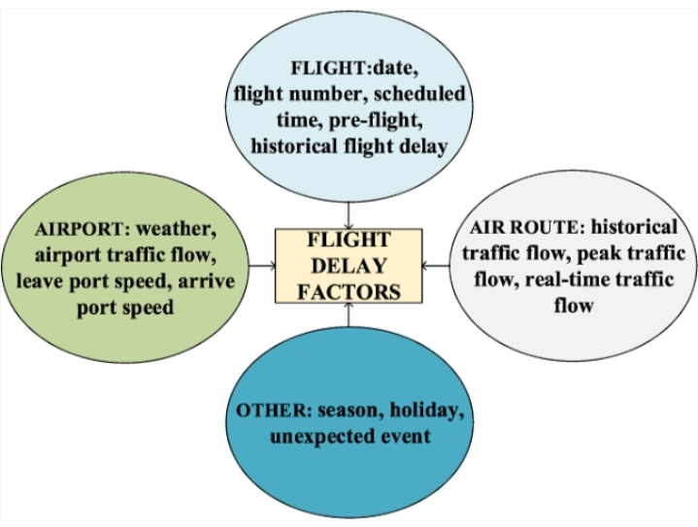
Project Flow
Data collection and preparation.
Exploratory data analysis.
Model building.
Performance testing.
Model deployment.

Slide 5
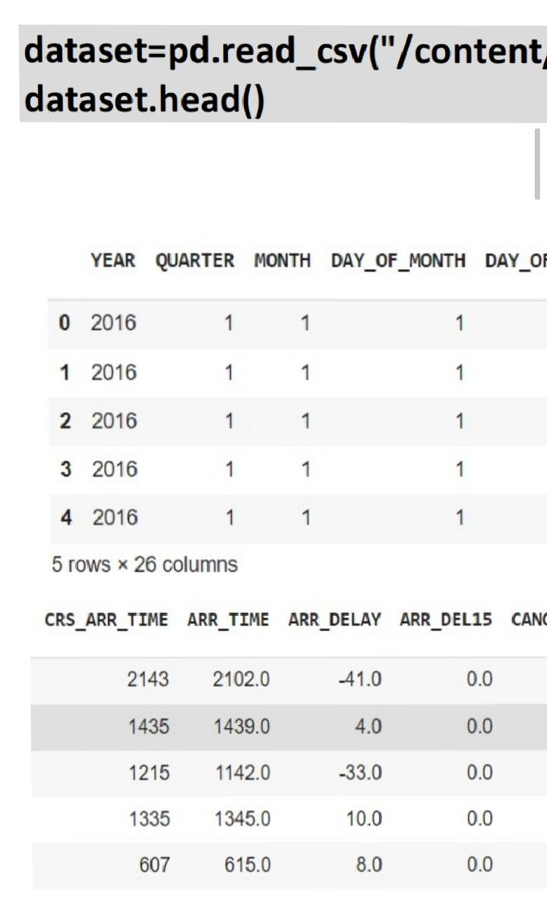
Data Collection and Preparation
Collecting and preparation the dataset is one of the most crucial parts whiled creating an ML project.
Download the dataset from (Kaggle) open sources.
Importing the necessary libraries.
Read the dataset.
Data preparation steps: Handling missing values, Handling categorical values.

Slide 6
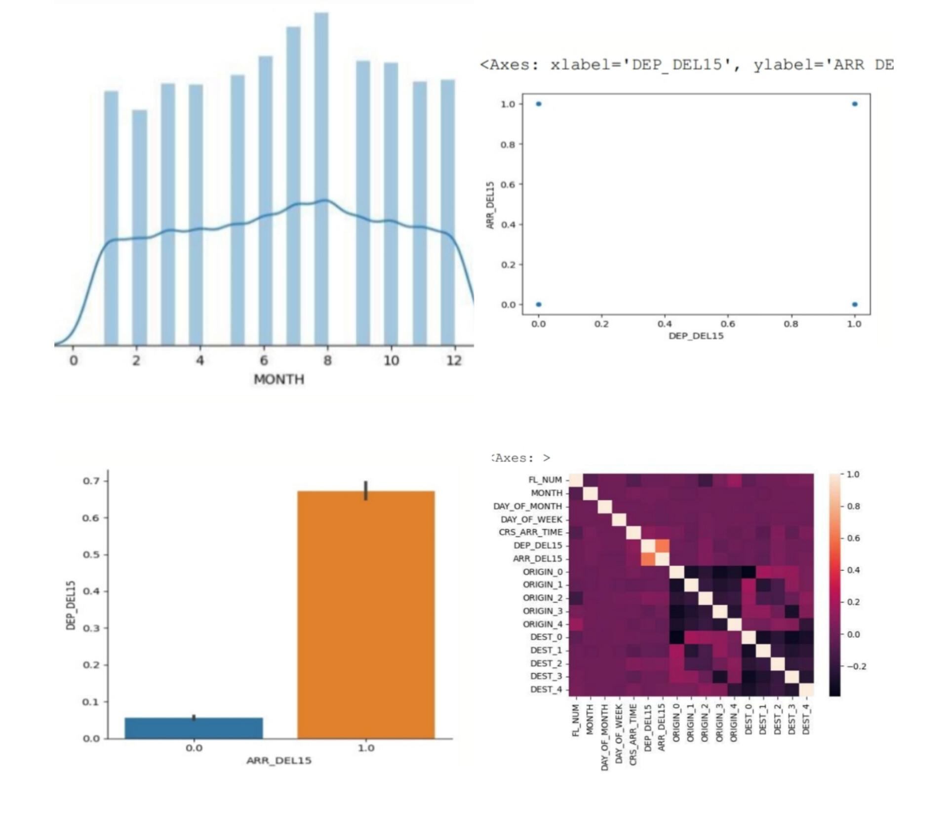
Exploratory Data Analysis
Exploratory data analysis is an approach to analysis the data using visual techniques.
Univariate analysis is understanding the data with a single feature.
Bivariate analysis is used two variables and compare them.
Multivariate analysis is to find the relation between multiple features.

Slide 7
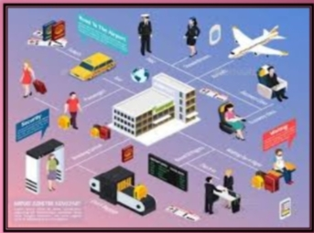
Model Building
In this step train our data on different algorithms.
Three classification algorithms:Random Forest Classifier, Decision Tree Model,ANN Model.
Building and training an ANN(Artificial Neural Network) model using keras library with Tensorflow as the backend.
Testing the model.

Slide 8
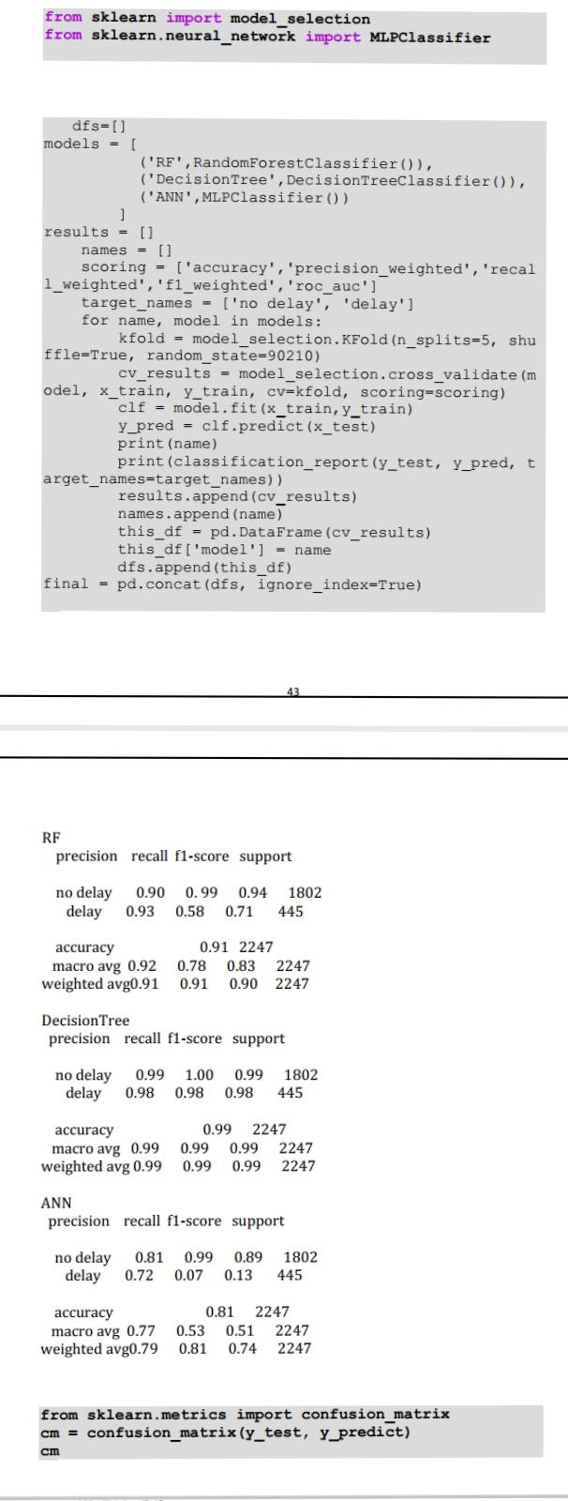
Performance Testing
Testing model with multiple evaluation metrics.
Compare the model
Comparing model accuracy before and after applying hyperparameter tuning.

Slide 9

Model Deployment
Save the best model.
Integrate with web framework.
Building HTML pages.
Run the web application.

Slide 10
Conclusion
Best model based on evolution techniques
Classification Tree
How the model and insights address the business need
Possible delays identified based on flight booking information
Alternative flights presented.
Way to improve the model
Include more input
Increase amount of data

Slide 11
Thank you

